Slide 1
Factory Method Pattern
slide 1

Slide 2
Intent
slide <number>
Interface for creating objects
Also Known As
  -> Virtual Constructor

Slide 3
Motivation
slide <number>
A class has subclasses, which subclass to instantiate is subject to change
We should not change the implement in client code
Solution: Make a factory class

Slide 4
Applicability
slide <number>
Use the Adapter pattern when
Class of objects change on runtime
Move responsibility to helper class

Slide 5
Participants
slide <number>
Product (Pasta)
  defines the interface of objects the factory method creates.
ConcreteProduct (Spaghetti..)
  implements the Product interface.
Creator (FactoryPatternDemo)
  declares the factory method, which returns an object of type Product.
ConcreteCreator (PastaFactory)
  overrides the factory method to return an instance

Slide 6
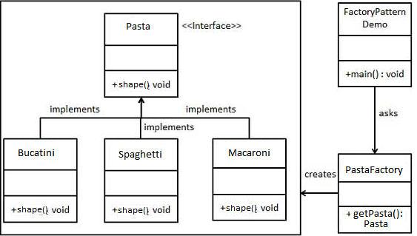
Structure
slide <number>

Slide 7
Collaborations
slide <number>
Creator depends on its subclasses to define the factory method to return an instance of the appropriate ConcreteProduct.

Slide 8
Consequences
slide <number>
Eliminate the need to specific classes in your code
Clients might have to subclass the Creator class

Slide 9
Implementation
slide <number>
Parameterize the Factory Method
In Demo:
  PastaFactory pf = new PastaFactory()
  pasta = PastaFactory.getPasta(“Spaghetti”)
In Factory:
  getPasta (String type) {
  if (type === “Spaghetti”)
  return new Spaghetti()
  if (type === “Macaroni”)
  return new Macaroni()
  ...
  }

